Slide 1
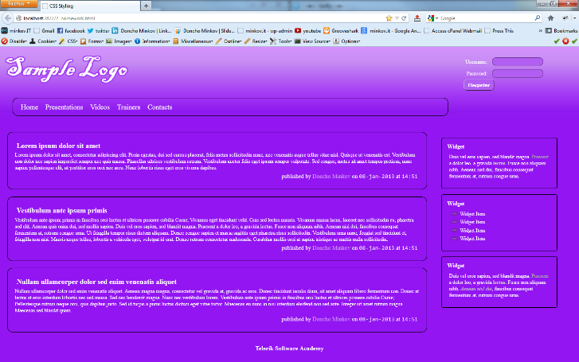
Homework
Implement the following using SASS
Use the HTML code from homework.html
Create the SASS easy to change (backgrounds, fonts)
Use mixins for clears, gradients)

Slide 2
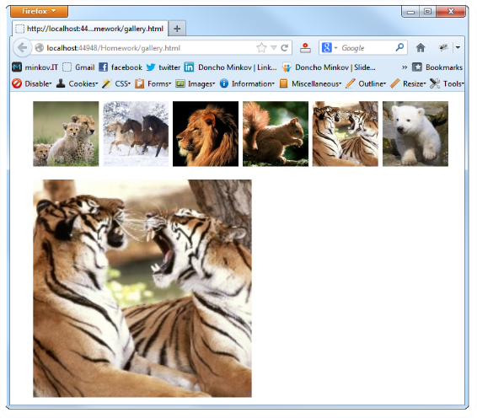
Homework (2)
Create a web gallery
Use only HTML, SASS and CSS
List images
When a image is selected, show it zoomed

